Slide 1
Applied Xeto | SkyPosium 2024
Leveraging new tech for the day-to-day toolkit
Michael Melillo, Solutions Architect | 10/17/2024

Slide 2
End Goal & Some Intro Concepts
Before we get started…

Slide 3
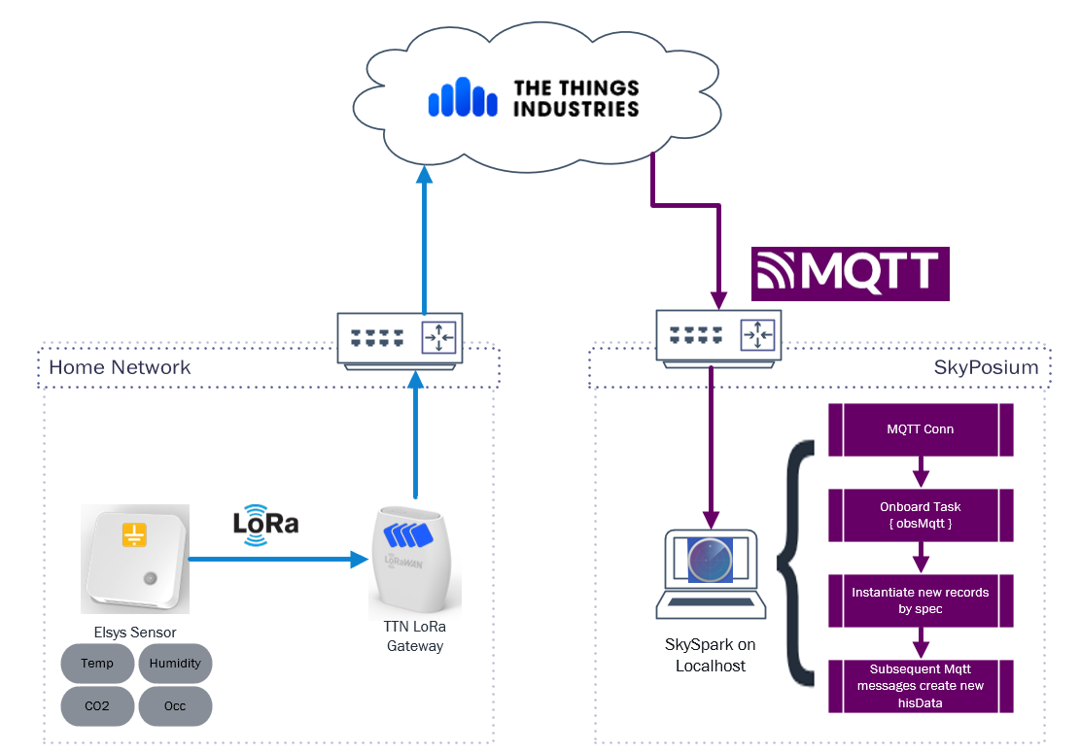
The End Goal
Sensor broadcasts data to Gateway
Gateway routes message from LAN through TTN Cloud
TTN MQTT Broker Application Publishes data to Subscribers
SkySpark MQTT Conn ingests MQTT Payload to configure records & ingest His Data

Slide 4
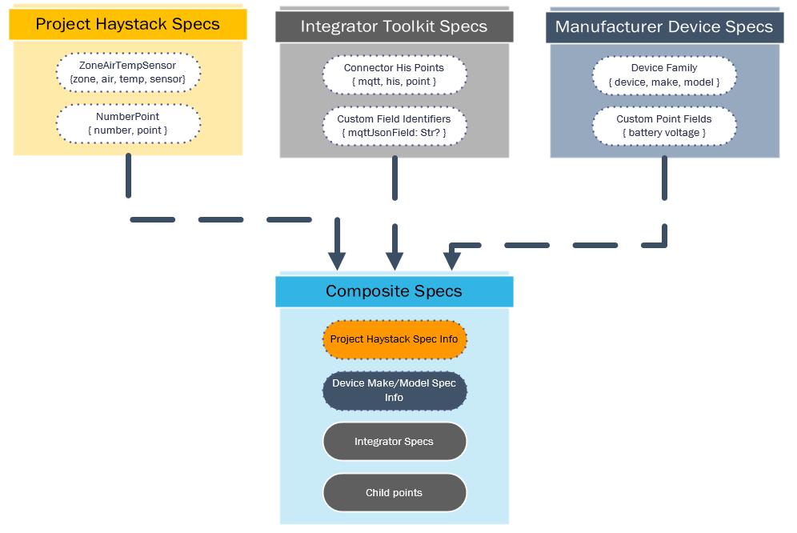
Composite Specs
ph.points, ph.equips, etc.
Manufacturer device specs
Practitioner specs (fit for your implementation)
Composite specs are a mix and combination of different kinds of data ready-made for deployment in projects.

Slide 5
Some helper functions
xeto init acme.mylib
Make sure your lib name is all lower case!
parseRef(“foo.lib::SpecName”).spec()
parseRef(“foo.lib”).specLib().specs()
spec.instantiate({graph}).map(row=> diff(null, row, {add}).commit())
From the git repo…
xeto_findSpecByStringName
xeto_findSpecByPropName

Slide 6
CSV Import
Now with xeto!

Slide 7
CSV Workflow
Define Ideal Import Structure (csv format, `id, navName, specName, fooRef`)
Create a new spec lib (mm.csv)
Define new specs
Review new xeto_csvImport() function
xetoReload()
Run new import

Slide 8
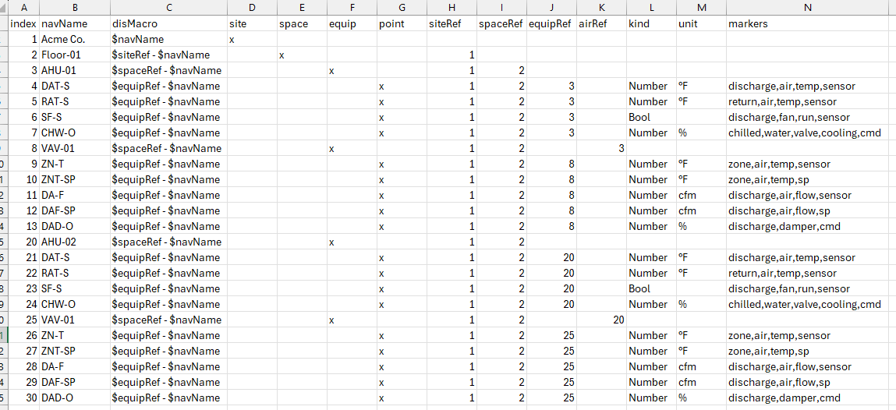
Traditional CSV Structure

Slide 9
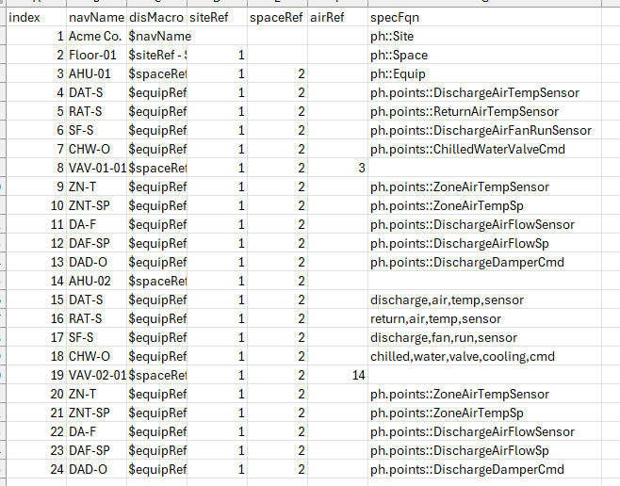
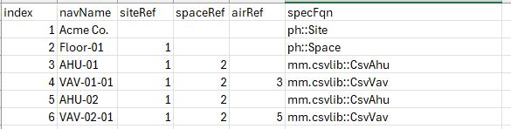
Spec Based CSV Structure
But why would we?
We could repeat the old structure

Slide 10
CSV Import Demo

Slide 11
Auto-Onboard Records
Leveraging obsMqtt to configure folio

Slide 12
MQTT Workflow
Review architecture
Inspect incoming MQTT payloads
Add new composite specs: Sensor-Points, Mqtt-His-Point, Elsys-Device
Review new xeto_mqttOnboard function
xetoReload()
Create obsMqtt task to consume MQTT traffic

Slide 13

MQTT Architecture
Sensor broadcasts data to Gateway
Gateway routes message from LAN through TTN Cloud
TTN MQTT Broker Application Publishes data to Subscribers
SkySpark MQTT Conn ingests MQTT Payload to configure records & ingest His Data

Slide 14
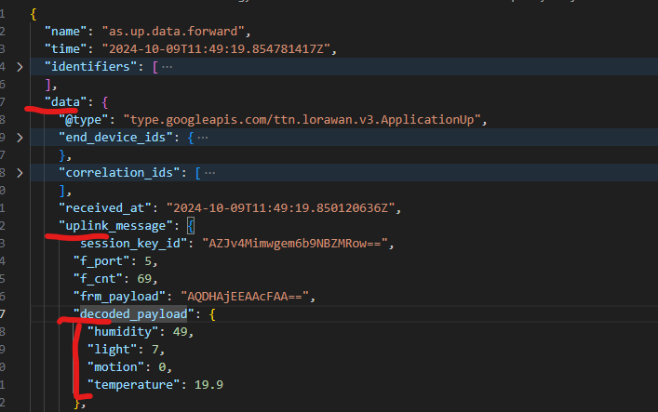
Payload Format
obsPayload -> data -> uplink_message -> decoded_payload
These payload fields play a role in our spec definitions, not just our import func

Slide 15
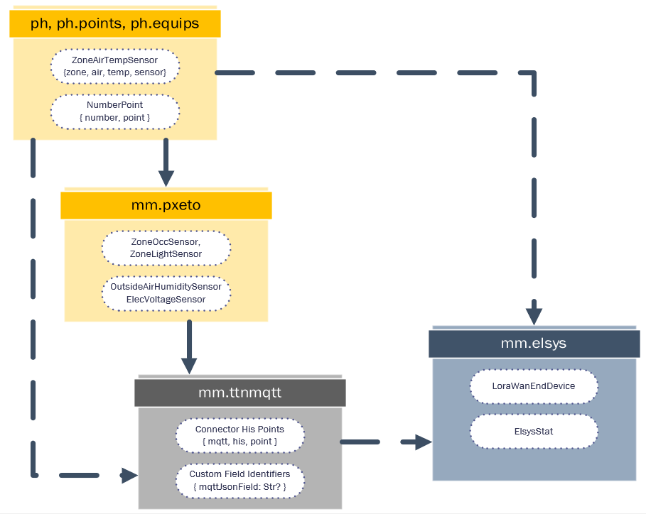
MQTT Demo Xeto Libs
mm.ttnmqtt
mm.pxeto
mm.elsys

Slide 16
MQTT Demo

Slide 17
Resources etc.
Source Code Repo: https://github.com/mikeMelillo/appliedXeto_skyposium2024
The Things Network
Elsys Sensors
LoRa Alliance
MQTT Protocol

